Slide 1
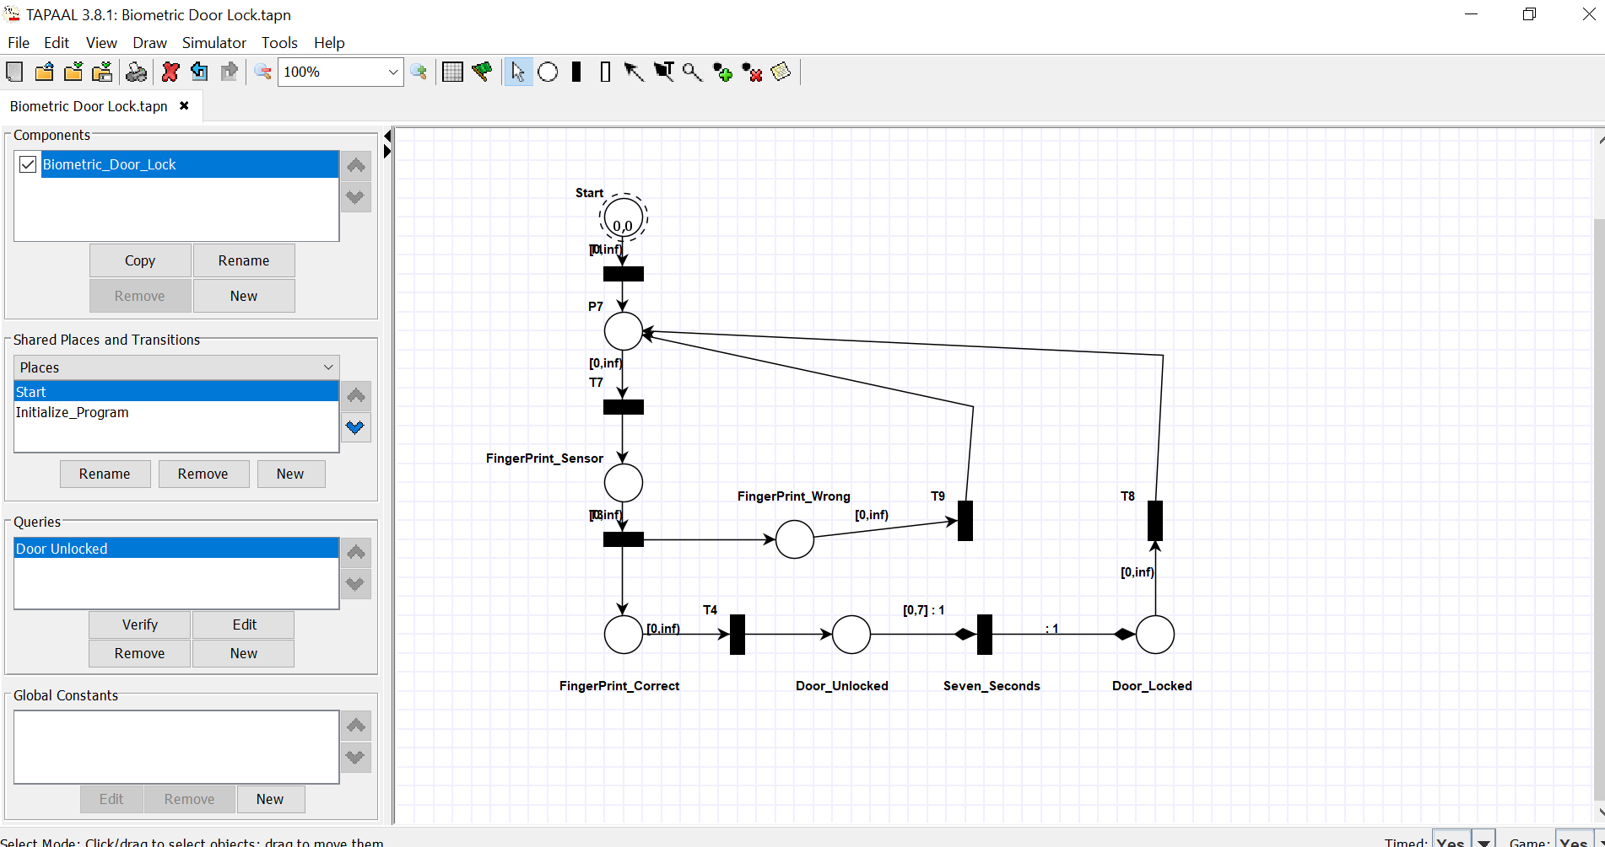
Task: 01 Validation & Verification in Tapaal Example

Slide 2
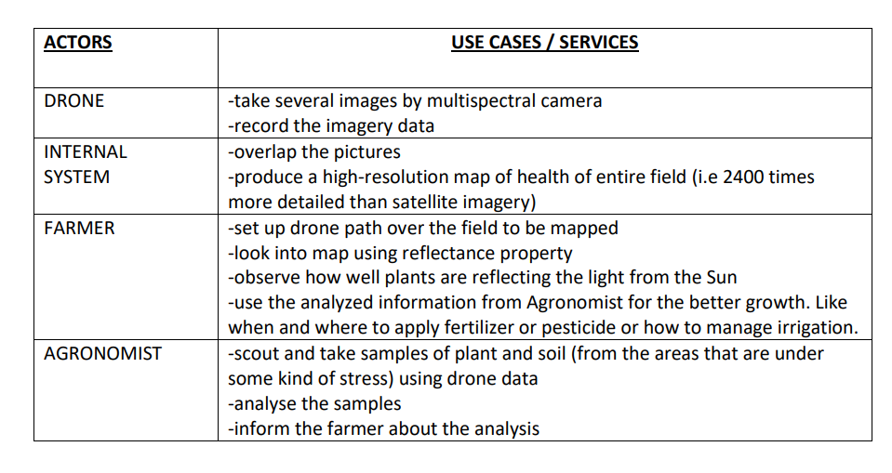
Task: 03 Use Case Specification

Slide 3
MAP DETAILS:
These maps give us an early warning and allow us to solve the problems. -plants in green areas of map are extremely healthy
-plants in red areas of map are facing serious issues like drainage problems, pest infestation,etc.
-plants in yellow-orange areas of map are suffering unhealthiness from early stage which human eye cannot identify that easy

Slide 4
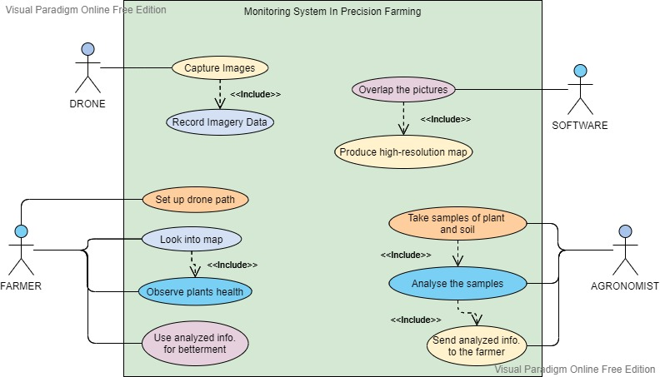

Slide 5
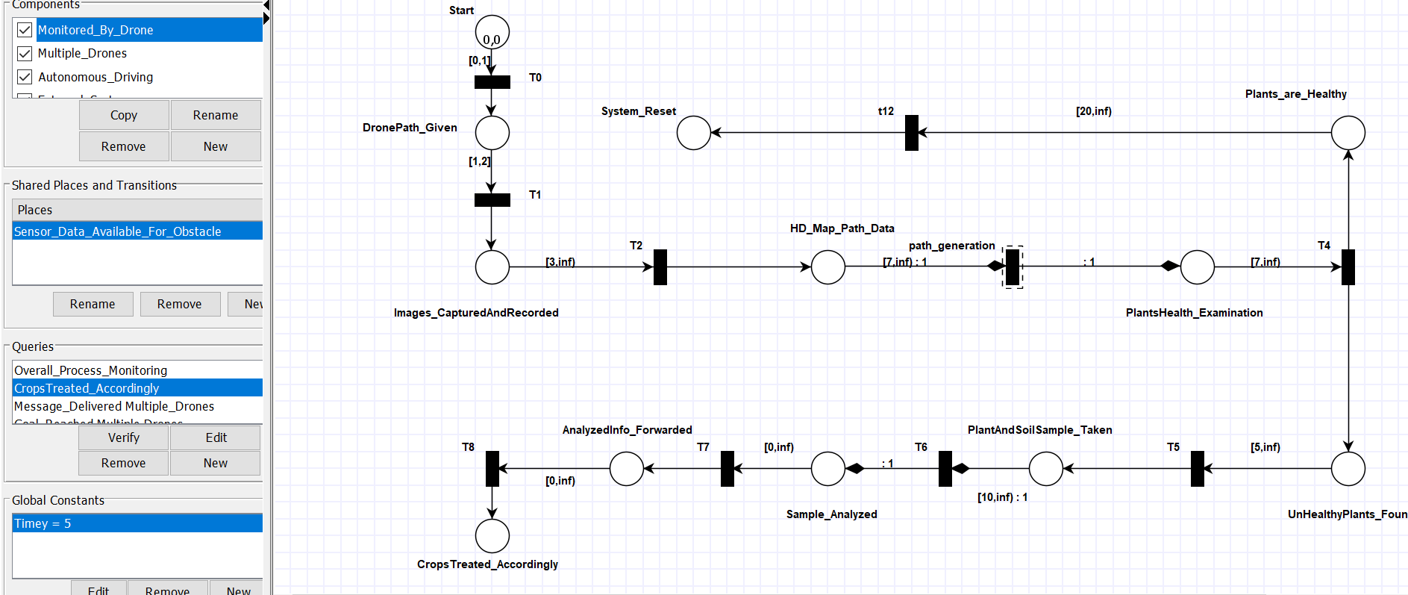
Task: 04 Model & Verify the Use Case

Slide 6
Pseudo-Code for “Monitored by Drone”
1. START
SET Drone to DronePath_Given
IF Drone is provided a path
THEN PRINT “Drone is ready to fly” ELSE
PRINT “Drone is not ready to fly”
ENDIF
2. READ Drone path and fly
FUNCTION images_CapturedAndRecorded capture images and record image data
RETURN image data
ENDFUNCTION images_CapturedAndRecorded
FUNCTION hD_Map_Path_Data
READ image data
COMPUTE HD Map
RETURN path generation
ENDFUNCTION hD_Map_Path_Data
3. FUNCTION plantsHealth_Examination
IF plants are healthy THEN
PRINT “System Reset” \\ Here our system will end when there are no unhealthy plants
ELSE
Go to upcoming functions/steps
ENDFUNCTION plantsHealth_Examination
4. FUNCTION plantAndSoilSample_Taken
Plant and soil sample will be taken and analyzed
RETURN analyzed info and forward to farmer
ENDFUNCTION plantAndSoilSample_Taken
FUNCTION cropsTreated_Accordingly
Look into the info and treat crops accordingly
PRINT “Monitoring is Done”
ENDFUNCTION cropsTreated_Accordingly
END

